Slide 1
Lab 3: 7-Segment Counter in Assembly
ECE 0202

Slide 2
Lab Outline
Download assembly template project from courseweb (same as lab 1)
Enable peripheral GPIO pins (4 output, 1 input)
Write a loop that updates output pins after a delay
Write logic within that loop to check if reset has been pressed
Show us counting 0-9 on the LCD (checkoff)
Show us that you have a reset button (checkoff)
Submit code (e.g. ‘main.s’) on courseweb

Slide 3
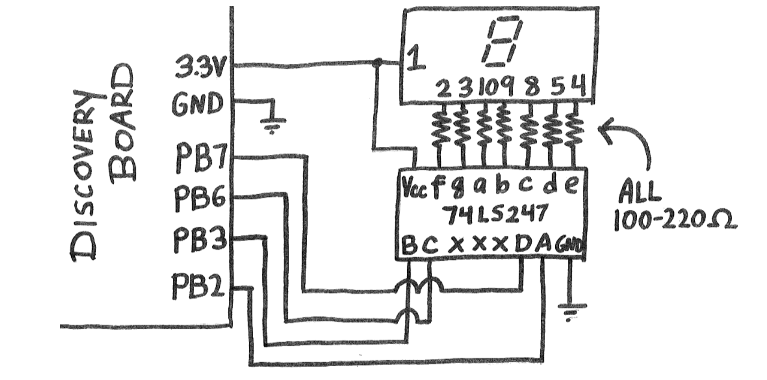
The Circuit

Slide 4
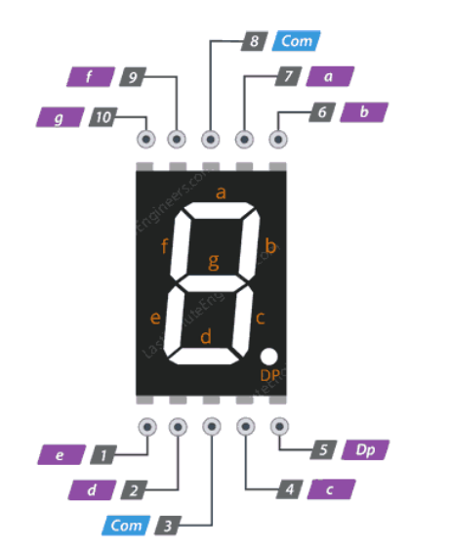
LCD Pinout
All lowercase letters should be connected to 7 segment display driver through the 220 Ω resistors

Slide 5
Enabling GPIO pins in Assembly
We need to do something called pre-indexing
Load the base register address
Load the value located in base register + offset
Change that value with bitwise operations
Store the value in the address of base register + offset
*See lecture 10 for more examples
*As well as the Pre-Lab for Lab 2
Equivalent C code: GPIOE->PUPDR |= 0x1;
LDR r0, =GPIOE_BASE
LDR r1, [r0, #GPIO_PUPDR]
ORR r1, #0x1
STR r1, [r0, #GPIO_PUPDR]

Slide 6
Control Logic
// My Pseudocode
Setup_GPIO();
while(1){ delay = 100;
while (delay !=0) {
delay -=1;
}
count++;
display(count);
check(reset);
}
Our main loop (after pin initialization)
Some delay operation
After the delay, we update our counter
Once per loop we check our reset button

Slide 7
Potential Steps for the Lab
Configure peripherals: GPIO (inputs and outputs)
Verify these using debugger
Wire up circuit using breadboard, 7-segment display and driver
Test that circuit works by writing out number like 3 and check that it is on display
Write logic for counting up
Add reset button

